Slide 1
Presentation of Technical Work
ME 226

Slide 2
!
How to perform good, understandable and enjoyable presentation ??!!!!!

Slide 3
1. Introduction
Much of your work evaluation is directly related to the quality of the presentation, which is based on the evaluator’s expectations.
quality work products generally:
  have a common general overall pattern of organization
  incorporate a number of common characteristics or traits (advantages).
You must understand what is expected in order to provide it.

Slide 4
quality work products generally:
  have a common general overall pattern of organization
  incorporate a number of common characteristics or traits.

Slide 5
2. An Organization Heuristic - The Presentation Sandwich
The expected general pattern is quite simple and consists of three parts (Presentation Sandwich):
  the front material, which has the one, overriding purpose of Orienting the Reader to the work,
  the work, which is the technical content of the work product, and
  the end material, which reviews or reflects on the work.

Slide 6
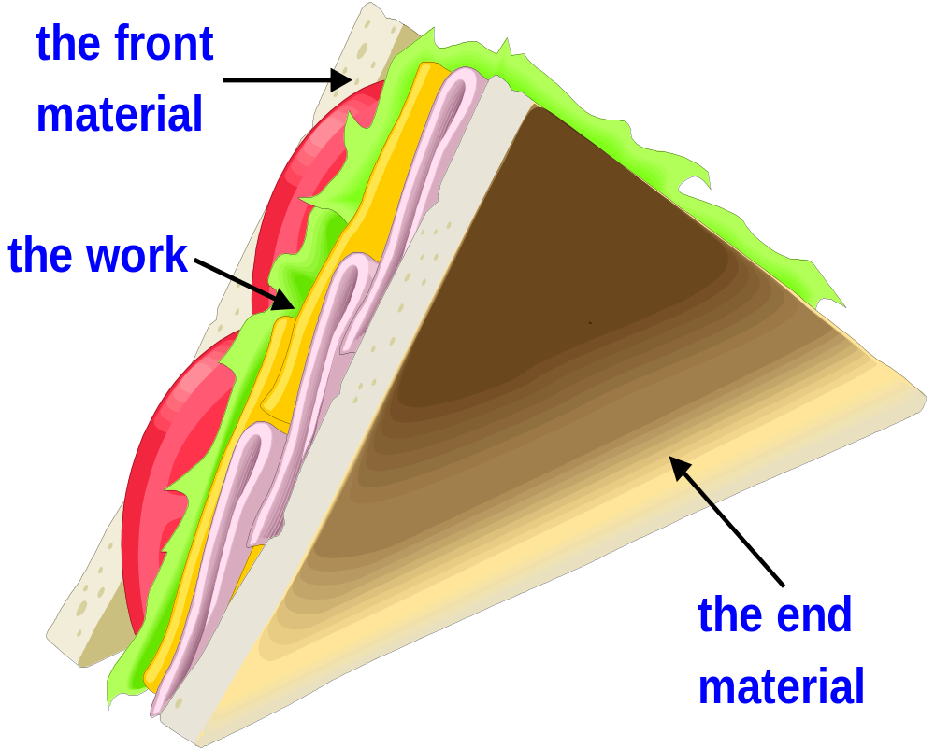
2. An Organization Heuristic - The Presentation Sandwich
The front and end materials are the pieces of bread holding the work (i.e., the tomatoes, lettuce, cheese and meat) together.
Just as a sandwich is not just the filling, so the presentation of technical work is not just the work.
You need to add the two slices of bread.

Slide 7
2. An Organization Heuristic - The Presentation Sandwich
These slices of bread take on different names depending on the type of work product you are preparing:
 | Homework and design project work | Oral reports, written reports, memos
Front | Context | Introduction
End | Discussion or Reflection | Summary or Conclusion

Slide 8
3. Common General Presentation Goals:
In addition to the expected general pattern of organization, there are other general presentation goals that enhance the quality of a work product.
Presentation Goals
1
2
3
4
5
6
Orient the reader
Explain the process
Make explanations clear
make the work readable
Who did the work and when
Clarify that the work has ended
It is crucial (important) that you let your reader (or yourself) know what is coming.
You must let the reader know what sort of technical work, what sort of results, will be found in the following pages.
You must inform the reader how the work is organized. Telling the reader why you did the work can help establish the desired point of view when the work is reviewed.

Slide 9
3. Common General Presentation Goals
In addition to the expected general pattern of organization, there are other general presentation goals that enhance the quality of a work product.
Presentation Goals
1
2
3
4
5
6
Orient the reader
Explain the process
Make explanations clear
make the work readable
Who did the work and when
Clarify that the work has ended
Keep the reader informed of the process used to generate the work:
  This means explaining (what – why – how ) this material is being attempted.

Slide 10
3. Common General Presentation Goals
In addition to the expected general pattern of organization, there are other general presentation goals that enhance the quality of a work product.
Presentation Goals
1
2
3
4
5
6
Orient the reader
Explain the process
Make explanations clear
make the work readable
Who did the work and when
Clarify that the work has ended
Explanations are generally clear to you but what about from the reader’s or assessor’s point of view?
Clarity is often difficult to achieve, in part, because of the existence of multiple realities (i.e., two entirely different, honest views of the same phenomena).
Using sketches, plots, figures, or some other graphical presentation to augment the text often enhances clarity.
To determine how clear your work product is, try having a peer review your work.

Slide 11
3. Common General Presentation Goals
In addition to the expected general pattern of organization, there are other general presentation goals that enhance the quality of a work product.
Presentation Goals
1
2
3
4
5
6
Orient the reader
Explain the process
Make explanations clear
make the work readable
Who did the work and when
Clarify that the work has ended
If you make the work easier to read you will improve the quality of the presentation.

Slide 12
3. Common General Presentation Goals
In addition to the expected general pattern of organization, there are other general presentation goals that enhance the quality of a work product.
Presentation Goals
1
2
3
4
5
6
Orient the reader
Explain the process
Make explanations clear
make the work readable
Who did the work and when
Clarify that the work has ended
It should always be clear who did the work and when the work was done.
This can be accomplished by dating and initialing each sheet of the work product.

Slide 13
3. Common General Presentation Goals
In addition to the expected general pattern of organization, there are other general presentation goals that enhance the quality of a work product.
Presentation Goals
1
2
3
4
5
6
Orient the reader
Explain the process
Make explanations clear
make the work readable
Who did the work and when
Clarify that the work has ended
When the work product involves several different tasks (e.g., several homework problems, consecutive design tasks) it should be clear when you have reached the end of each task.
The reader expects some type of End of Task marker.
This marker could be a discussion of the work, a reflection on the work, or a summary of the work.
In other words it should be clear to the reader or assessor when he has reached the end material.

Slide 14


4. Presentation of Homework Assignments
Homework Assignments
Set the Context (appropriate expression) For The Work
Do the Work
Discuss the Results of Your Analysis
Explain what is coming (i.e., set the context for the work).
Write the context before you actually do the work. Writing the Context will help you focus your thinking.
Explain why the work will be done (e.g., This is a homework assignment on Truss-equilibrium)
Tell what will be accomplished when the work is done (e.g., After this assignment is completed I will have shown that I know how to do force balances and that I will be prepared for the upcoming quiz).
Tell how this work fits into a bigger problem (e.g., This is the third assignment from Chapter 3).

Slide 15
4. Presentation of Homework Assignments
Homework Assignments
Set the Context For The Work
Do the Work
Discuss the Results of Your Analysis
Sign and date your work. You should get into the habit of signing and dating all work that you do.
Appropriate diagrams or sketches. The diagrams should present the information given in the problem as well as what is required.
A description of your analysis process: Describe what process, methods, and approaches you plan to use in analyzing the problem.
The analysis: present all of your analysis, including all appropriate intermediate results. Note that presentation of the analysis process is as important as the final result obtained from the analysis.
Plots and tables: Clarity requires that the reader know your point of view about what the tables and/or plots show.

Slide 16
4. Presentation of Homework Assignments
Homework Assignments
Set the Context For The Work
Do the Work
Discuss the Results of Your Analysis
Comment on one of the following:
What was learned (e.g., The frame weight was 34 kilograms which is much lighter than any machine we have found in the stores).
The analysis process used in working the problem (e.g., “I could not work this problem until I realized I could replace 1 with sin²(θ) + cos²(θ)).
The correctness of the result (e.g., “The answer to this problem is 14.6 m², which matches the answer in the back of the book” or “This weight of 34 kilos, while it seems light, is probably correct”).
What will happen next (e.g., “Now we can calculate the cost of our device”.

Slide 17
Specific Presentation Expectations
Homework Assignments
Graphical Material
Plots
Mathematical Model
Reports

Slide 18
Specific Presentation Expectations
Homework Assignments
Set the Context For The Work
Do the Work
Discuss the Results of Your Analysis
Explain what is coming (general goal).
-Write the context before you actually do the work.
- Writing the Context will help you focus your thinking about what you are about to do.
Explain why the work will be done
Tell what will be accomplished when the work is done .
Tell how this work fits into a bigger problem

Slide 19
Specific Presentation Expectations
Homework Assignments
Set the Context For The Work
Do the Work
Discuss the Results of Your Analysis
Sign and date your work. You should get into the habit of signing and dating all work that you do.
Appropriate diagrams or sketches. The diagrams should present the information given in the problem as well as what is required.
A description of your analysis process: Describe what process, methods, and approaches you plan to use in analyzing the problem.
The analysis: present all of your analysis, including all appropriate intermediate results. Note that presentation of the analysis process is as important as the final result obtained from the analysis.
Plots and tables: Clarity requires that the reader know your point of view about what the tables and/or plots show.

Slide 20
Specific Presentation Expectations
Homework Assignments
Set the Context For The Work
Do the Work
Discuss the Results of Your Analysis
Comment on following:
What was learned
The analysis process used in working the problem
The correctness of the result
What will happen next

Slide 21
Specific Presentation Expectations
Graphical Material
Create Stand-alone graphics
Discuss the graphics
Give each graphic a complete, descriptive title
Define all variables that are part of the graphic
Darken any light grids on the graphic
Prepare the graphical material so that it can be reproduced

Slide 22
Specific Presentation Expectations
Graphical Material
Create Stand-alone graphics
Discuss the graphics
Naming the piece of data you are discussing
Saying what it is that is important about the selected piece of data.

Slide 23
Specific Presentation Expectations
Plots
Labeled both axes of the plot, including units
Mark the division of each axis
Add a descriptive title, including a Plot or Figure number
Use concise (short and clear), descriptive legend
Show the experimental data points used in generating the plot
Draw smooth curves through or near the data points to show the trend

